Slide 1
Horticultural Lighting V2.0
Final Requirements
Effective Date: March 31, 2021
September 17, 2020
Date

Slide 2
Agenda
Introduction
Webinar Logistics
V2 Overview and Timeline
Technical Policy Revisions
New Types of Applications
Q&A

Slide 3
Introductions
Presenters
Q&A Support
Axel Pearson
Senior Technical Product Manager
Kasey Holland
Technical Manager
Leora Radetsky
Senior Lighting Scientist
Aaron Feldman
Senior Technical Operations Analyst

Slide 4
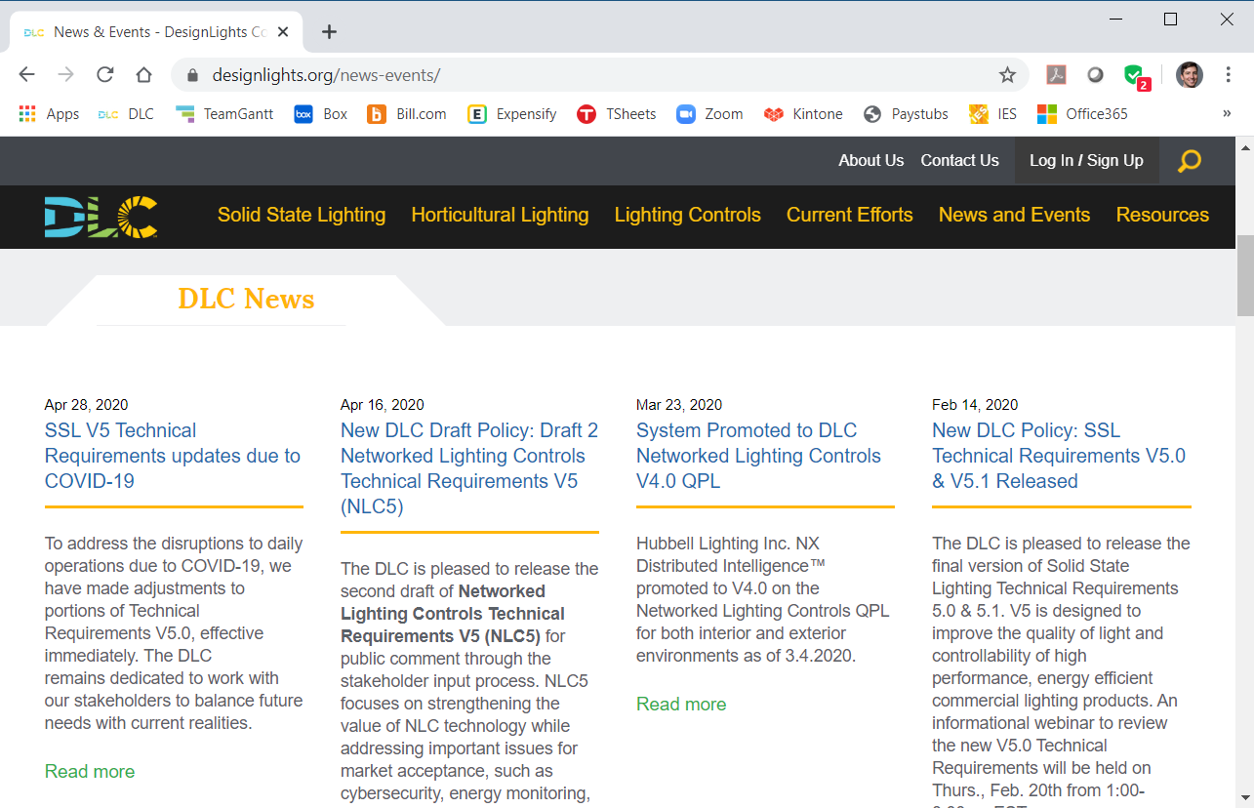
Webinar Logistics
Slides and recorded webinar will be posted on the DLC News & Events page at www.designlights.org shortly after today’s presentation
All attendees are automatically muted
If you experience technical issues, please use the chat feature to let us know

Slide 5
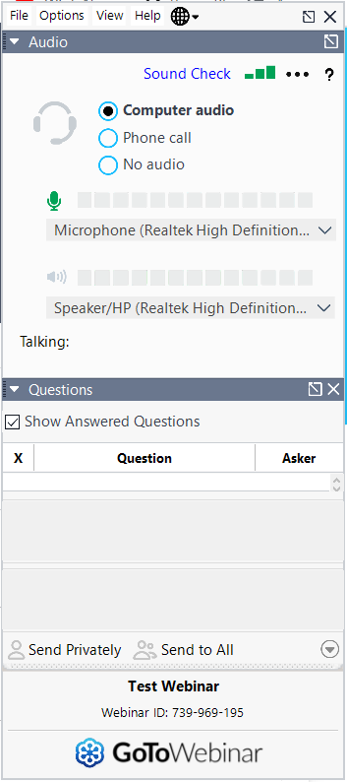
Questions and Answers
We will leave 15 minutes after the presentation to answer questions. Please enter your Questions pane in GoToWebinar.
DLC technical support team will answer questions as they come in via the questions pane
Some questions will be answered aloud (anonymously) at the end during the Q&A session

Slide 6
V2 Overview and Timeline

Slide 7
Hort Version 2.0
Updates to the V1.2 Technical Requirements include:
Aligning with ASABE S640 Abbreviations and Details
Alignment with UL 8800
Requirements for TM-33-18 reporting
Two new optional reported metrics associated with the biologically-active radiation range for plants (280-800nm)
Introduces new application types:
Family Grouping
Private Label

Slide 8
Hort Version 2.1
Version 2.0 will be directly followed by V2.1
Considers adding eligibility for
LED lamp products
DC and Modular systems
Products with externally-supplied active cooling capabilities
V2.0 will not be impacted by V2.1
I.e. No delisting impacts from V2.1
Draft 1 to be released October 2020

Slide 9
Hort Version 2 Timeline
V2.0
ASABE terminology
UL 8800
TM-33 Reporting
PBAR Optional Reporting
Family Grouping
Private Labeling
2020
2021
V2.0 Draft 1 Release
V2.0 Final Release
V2.0 Effective
May 6
Comment Period
Targeted Outreach
Sept
Mar
V2.0
V2.1
New product types:
Lamps
DC and Modular
Externally-supplied Active Cooling
V2.1
Draft 1 Release
V2.1
Draft 2 Release
V2.1 Final Release
V2.1 Effective
Oct
Comment Period
Mar
Comment Period
June
July
V2.1

Slide 10
Revisions to the Hort Technical Requirements

Slide 11
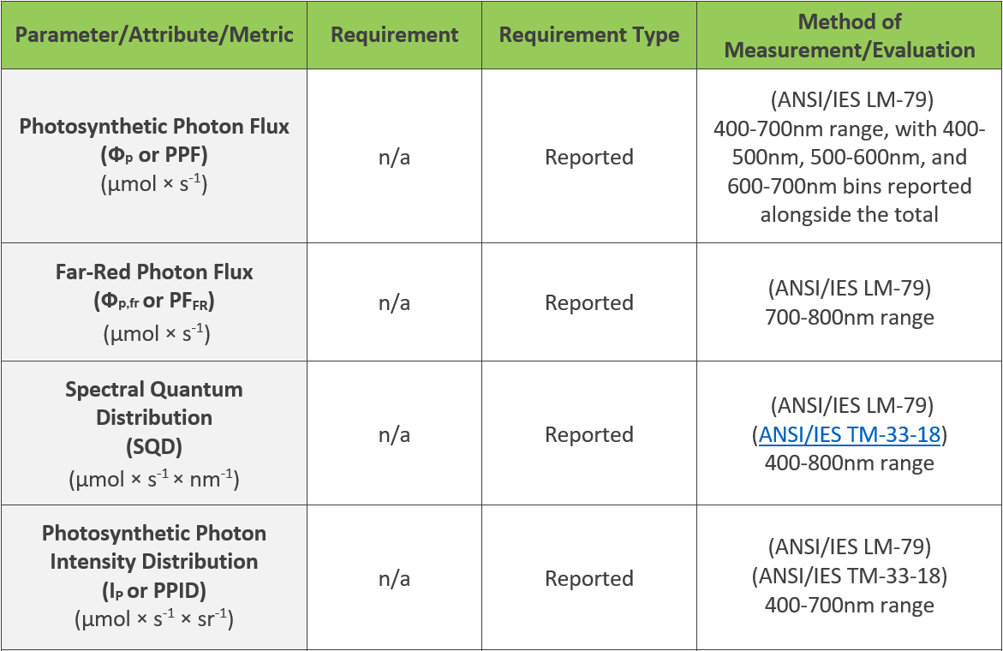
Aligning with ASABE S640 Abbreviations and Details
ANSI/ASABE S640: Quantities and Units of Electromagnetic Radiation for Plants (Photosynthetic Organisms)

Slide 12
Maintain Efficacy Threshold
Draft 1 proposed PPE increased to ≥ 2.10 µmol × J-1
However, after receiving comments on Draft 1 and performing additional research / outreach, we have decided to maintain current efficacy threshold
DLC’s -5% tolerance on efficacy has not changed

Slide 13
Aligning with UL 8800
Products are now required to be certified by an OSHA NRTL or SCC recognized body to ANSI/UL 8800 (ANSI/CAN/UL 8800)
Applicable for horticultural lighting products by that safety organization.

Slide 14
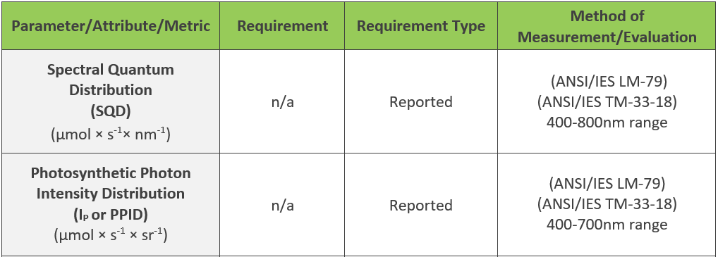
TM-33-18 reporting
Originally proposed in Version 1.2, delayed to V2.0
PPID and SPD to be reported in the ANSI/IES TM-33-18 .xml format (SQD shall be derived from SPD)
All applications will be required to provide spectral and spatial distribution information in an .xml file per ANSI/IES TM-33-18.
LM-63 and TM-27 (.ies and .spdx files) provisionally accepted - Update Applications required by December 31, 2021.

Slide 15
PF_{PBAR} and PE_{PBAR} Optional Reporting
According to the American Society of Agricultural and Biological Engineering (ASABE), 280-800nm covers a broader range of radiation that effects plant biology
Summation of ultraviolet radiation (280-400nm) and far-red radiation (700-800nm) in addition to PAR (400-700nm)

Slide 16
New Types of Applications

Slide 17
Family Grouping
 | Model | Wattage | Distribution | Spectrum | Voltage
 | DLC | 100 | Distribution A | Spectrum A | 120-277, 347, 480 | Spectral Sub-Group
 | DLC | 100 | Distribution B | Spectrum A | 120-277, 347, 480
 | DLC | 200 | Distribution A | Spectrum A | 120-277, 347, 480
 | DLC | 200 | Distribution B | Spectrum A | 120-277, 347, 480
 | DLC | 300 | Distribution A | Spectrum A | 120-277, 347, 480
 | DLC | 300 | Distribution B | Spectrum A | 120-277, 347, 480
 | DLC | 400 | Distribution A | Spectrum A | 120-277, 347, 480
 | DLC | 400 | Distribution B | Spectrum A | 120-277, 347, 480
 | DLC | 100 | Distribution A | Spectrum B | 120-277, 347, 480 | Spectral Sub-Group
 | DLC | 100 | Distribution B | Spectrum B | 120-277, 347, 480
 | DLC | 200 | Distribution A | Spectrum B | 120-277, 347, 480
 | DLC | 200 | Distribution B | Spectrum B | 120-277, 347, 480
 | DLC | 300 | Distribution A | Spectrum B | 120-277, 347, 480
 | DLC | 300 | Distribution B | Spectrum B | 120-277, 347, 480
 | DLC | 400 | Distribution A | Spectrum B | 120-277, 347, 480
 | DLC | 400 | Distribution B | Spectrum B | 120-277, 347, 480
 | DLC | 100 | Distribution A | Spectrum C | 120-277, 347, 480 | Spectral Sub-Group
 | DLC | 100 | Distribution B | Spectrum C | 120-277, 347, 480
 | DLC | 200 | Distribution A | Spectrum C | 120-277, 347, 480
 | DLC | 200 | Distribution B | Spectrum C | 120-277, 347, 480
 | DLC | 300 | Distribution A | Spectrum C | 120-277, 347, 480
 | DLC | 300 | Distribution B | Spectrum C | 120-277, 347, 480
 | DLC | 400 | Distribution A | Spectrum C | 120-277, 347, 480
 | DLC | 400 | Distribution B | Spectrum C | 120-277, 347, 480
 | DLC | 100 | Distribution A | Spectrum D | 120-277, 347, 480 | Spectral Sub-Group
 | DLC | 100 | Distribution B | Spectrum D | 120-277, 347, 480
 | DLC | 200 | Distribution A | Spectrum D | 120-277, 347, 480
 | DLC | 200 | Distribution B | Spectrum D | 120-277, 347, 480
 | DLC | 300 | Distribution A | Spectrum D | 120-277, 347, 480
 | DLC | 300 | Distribution B | Spectrum D | 120-277, 347, 480
 | DLC | 400 | Distribution A | Spectrum D | 120-277, 347, 480
 | DLC | 400 | Distribution B | Spectrum D | 120-277, 347, 480
Compared to testing and listing all products individually
Reduce overall burden associated with listing multiple, similar product variations.
Reduce the total application fees.
Familiarity with FG from SSL Program
32 individually tested and listed on Hort QPL

Slide 18
Family Grouping
 | Model | Wattage | Distribution | Spectrum | Voltage
 | DLC | 100 | Distribution A | Spectrum A | 120-277, 347, 480 | Spectral Sub-Group
 | DLC | 100 | Distribution B | Spectrum A | 120-277, 347, 480
 | DLC | 200 | Distribution A | Spectrum A | 120-277, 347, 480
 | DLC | 200 | Distribution B | Spectrum A | 120-277, 347, 480
 | DLC | 300 | Distribution A | Spectrum A | 120-277, 347, 480
 | DLC | 300 | Distribution B | Spectrum A | 120-277, 347, 480
 | DLC | 400 | Distribution A | Spectrum A | 120-277, 347, 480
 | DLC | 400 | Distribution B | Spectrum A | 120-277, 347, 480
 | DLC | 100 | Distribution A | Spectrum B | 120-277, 347, 480 | Spectral Sub-Group
 | DLC | 100 | Distribution B | Spectrum B | 120-277, 347, 480
 | DLC | 200 | Distribution A | Spectrum B | 120-277, 347, 480
 | DLC | 200 | Distribution B | Spectrum B | 120-277, 347, 480
 | DLC | 300 | Distribution A | Spectrum B | 120-277, 347, 480
 | DLC | 300 | Distribution B | Spectrum B | 120-277, 347, 480
 | DLC | 400 | Distribution A | Spectrum B | 120-277, 347, 480
 | DLC | 400 | Distribution B | Spectrum B | 120-277, 347, 480
 | DLC | 100 | Distribution A | Spectrum C | 120-277, 347, 480 | Spectral Sub-Group
 | DLC | 100 | Distribution B | Spectrum C | 120-277, 347, 480
 | DLC | 200 | Distribution A | Spectrum C | 120-277, 347, 480
 | DLC | 200 | Distribution B | Spectrum C | 120-277, 347, 480
 | DLC | 300 | Distribution A | Spectrum C | 120-277, 347, 480
 | DLC | 300 | Distribution B | Spectrum C | 120-277, 347, 480
 | DLC | 400 | Distribution A | Spectrum C | 120-277, 347, 480
 | DLC | 400 | Distribution B | Spectrum C | 120-277, 347, 480
 | DLC | 100 | Distribution A | Spectrum D | 120-277, 347, 480 | Spectral Sub-Group
 | DLC | 100 | Distribution B | Spectrum D | 120-277, 347, 480
 | DLC | 200 | Distribution A | Spectrum D | 120-277, 347, 480
 | DLC | 200 | Distribution B | Spectrum D | 120-277, 347, 480
 | DLC | 300 | Distribution A | Spectrum D | 120-277, 347, 480
 | DLC | 300 | Distribution B | Spectrum D | 120-277, 347, 480
 | DLC | 400 | Distribution A | Spectrum D | 120-277, 347, 480
 | DLC | 400 | Distribution B | Spectrum D | 120-277, 347, 480
Reduce overall burden and cost by reviewing worst-case models within a family.
Parent products demonstrate compliance with the Technical Requirements for child products.
Parent products rely on tested data, child products rely on reported data.
Worst-case criterion reporting and threshold requirements per V2.0.
8 individually tested, 32 listed on Hort QPL

Slide 19
Private Labeling
V2.0 allows re-listing of products under multiple organizations and brands
Private Label products must be exactly the same as the OEM products
OEM products must already be listed on the Horticultural QPL
Private Label products should not need to go through redundant testing
Overall, a simplified application review process for pre-approved products
Manufacturer and product relationships must be clearly understood and documented

Slide 20
Hort Version 2.0: Summary of Changes
Updates to the V1.2 Technical Requirements include:
Aligning with ASABE S640 Abbreviations and Details
Alignment with UL 8800
Requirements for TM-33-18 reporting
Two new optional reported metrics associated with the biologically-active radiation range for plants (280-800nm)
Introduces new application types:
Family Grouping
Private Label

Slide 21
Question and Answers

Slide 22
Hort Webinar Wednesdays
Join us for a series of three 1-hour webinars followed by an additional 1-hour deep dive working group discussion session!
Save the dates:
July 29, 2020
August 26, 2020
September 23, 2020
To register for the final date and view recorded webinars, visit the Webinar Wednesdays webpage at:
https://www.designlights.org/news-events/events/horticultural-webinar-wednesdays/

Slide 23
Next Steps
Hort V2.1
Draft 1 released next month
Draft 2 expected March 2021
Final expected in June 2021, effective July 2021
Manufacturer and Industry Guidance will be released before the V2.0 effective date (March 31, 2021), with a webinar to review submission process for the new requirements
Explains how the V2.0 requirements will be implemented and offers information for manufacturers who wish to update their product listings during the grace period
Includes information on fees and review timing
Products must update to Version 2 before December 31, 2021
Notes:
All currently listed V1.2 products and those products using the provisional TM-33 reporting option must update by the end of 2021.

Slide 24
Thank you!
Questions about applications and general inquiries should be sent to:
Horticulture@DesignLights.org

